Slide 1
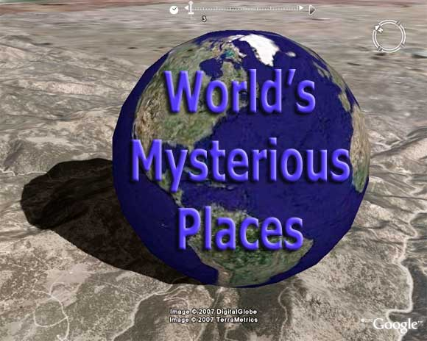

Slide 2
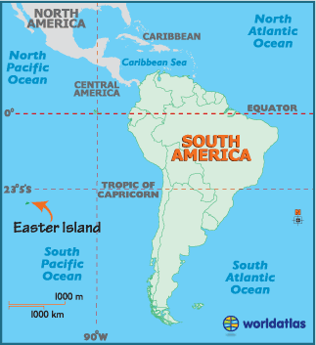
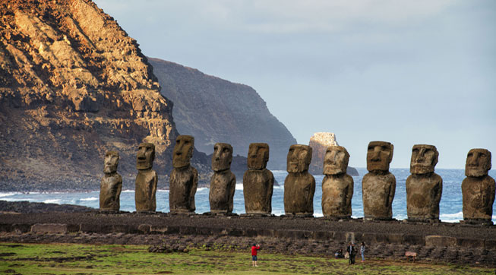
Easter Island

Slide 3
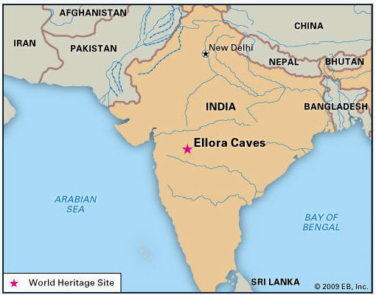
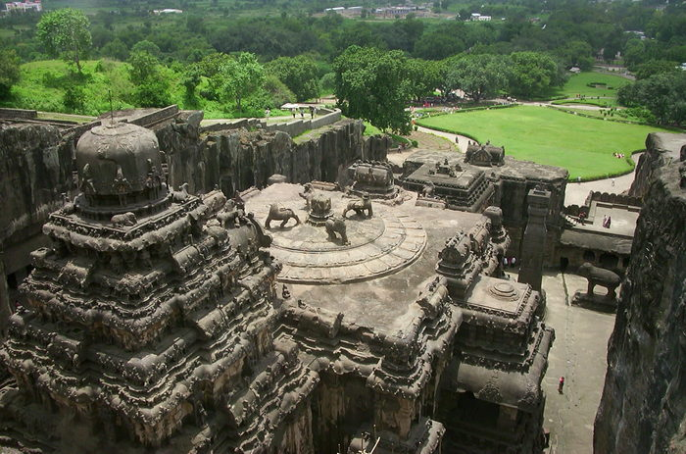
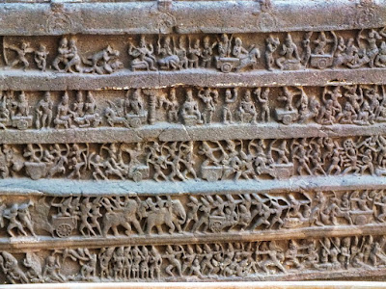
Kailasa Temple

Slide 4
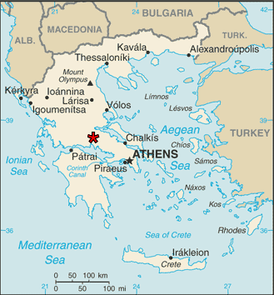
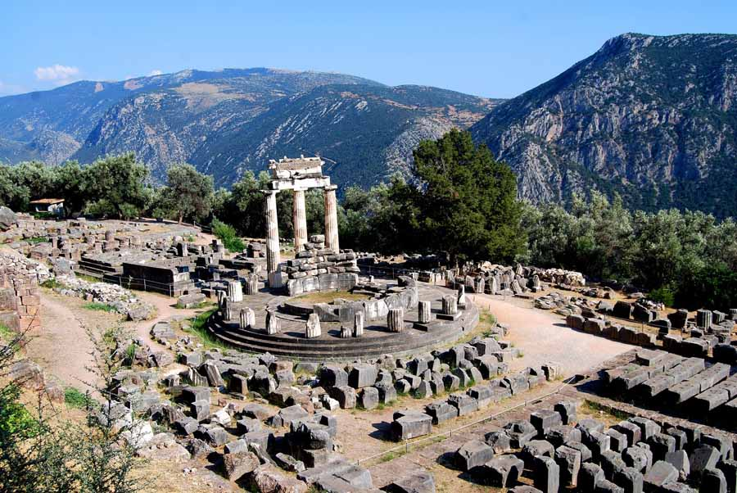
Delphi

Slide 5
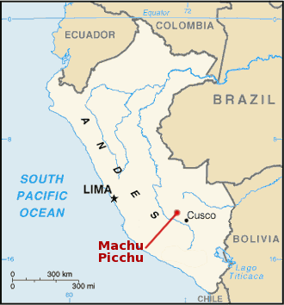
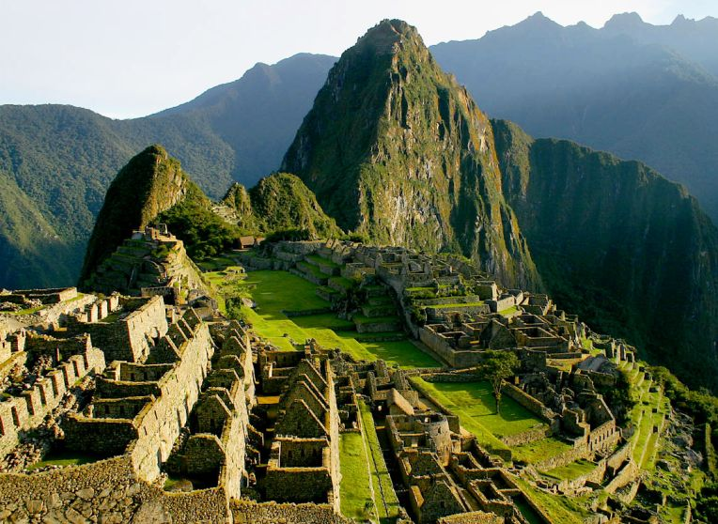
Machu Picchu

Slide 6

Мatch the words with their meanings
worshipped
invisible
consult
unique
transported
feat
symbols
remote
presented
properties
praised the gods
not able to be seen
ask for advice
one of a kind
moved
achievement
designs to represent sth else
far away
kept in a good condition
qualities

Slide 7


Top “fives” of the lesson
the most talkative student?
the most active participant?
the most unexpected answer?
the most original idea?
the most memorable question?

